Slide 1
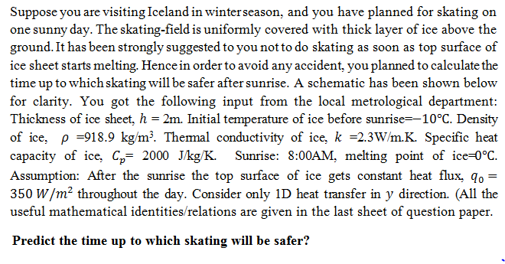
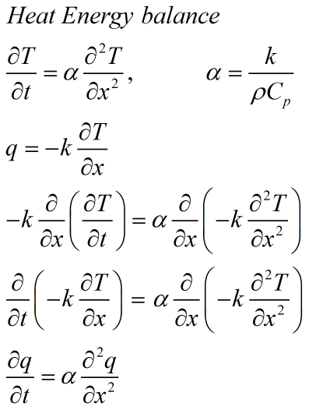
Example 1:

Slide 2





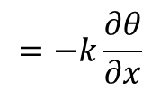


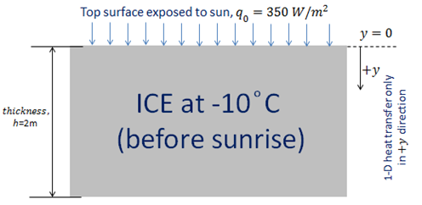


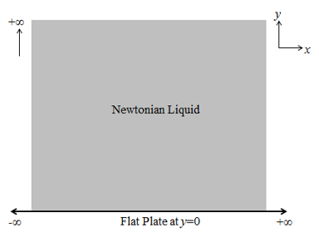









Slide 3






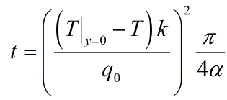




= 45 min
*As our duration of observation is very less as compared to , hence our observation
time can be safely considered as early times, hence domain can be treated as semi-infinite
domain, hence error function solution is valid.

